Slide 1
NATIONAL CENTER FOR MISSING & EXPLOITED CHILDREN
New Initiatives to Support Survivors of
Child Sexual Abuse Imagery Distribution

Slide 2
BEFORE WE BEGIN
This presentation is considered confidential NCMEC material and is intended only for legal professionals dedicated to representing victims.
Please do not share, photograph or reproduce information contained in this presentation. NCMEC is happy to work with you to ensure you have the information you need from this presentation to support your work.
Thank you for your cooperation.
Please do not reproduce or distribute without the written authorization of NCMEC.
Notes:
Looking at the victim perspective, the submission to NCMEC starts the train for notification and victim impact statements.

Slide 3
NCMEC: WHO WE ARE
Founded in 1984
Nonprofit, non-governmental organization with a mission to help find missing children, reduce child sexual exploitation, and prevent child victimization
Congressionally funded in part to operate 15 core programs related to missing and exploited children
National resource center for families, law enforcement, and other professionals
Learn more at missingkids.org
Please do not reproduce or distribute without the written authorization of NCMEC.
Notes:
Looking at the victim perspective, the submission to NCMEC starts the train for notification and victim impact statements.

Slide 4
ONLINE CHILD SEXUAL ABUSE IMAGERY (CSAI)
More than distribution/collection of sexually abusive files
It starts with a crime scene
CSAI victims are unique:
Victims hiding in plain sight
No one knows a crime is happening
Very personal crime
Limited disclosure
Please do not reproduce or distribute without the written authorization of NCMEC.
Notes:
As we start today it’s important to remember we are talking about the sexual abuse and exploitation of children where the offender chose to memorialize the abuse with photos or videos
You can have a contact-offender of 20 years against 50 children who never took a picture – we’re focused on those who take that next step
NCMEC’s focus in CVIP has always been on what we are SEEING in the image or video – it’s not just a word doc or a xls or a pdf – it’s not just a computer file
It’s a crime scene and we need to understand who and what and why it’s happening
Kids are exactly who they should be with
Unlike missing kids cases, no one knows there’s a crime, child has worst and biggest secret to bear
Crime against the child and also the family
We’ll talk about how close to the child the offenders are, which means more and longer abuse, which means more control over the child and less disclosure
Hidden in plain sight – children who are going to school everyday, on sports teams, living with in-tact families, etc.
Child sexual abuse happening in homes across the US
When do we learn about this? Who is teaching us these messages?
Who sees the signs that something is wrong?

Slide 5
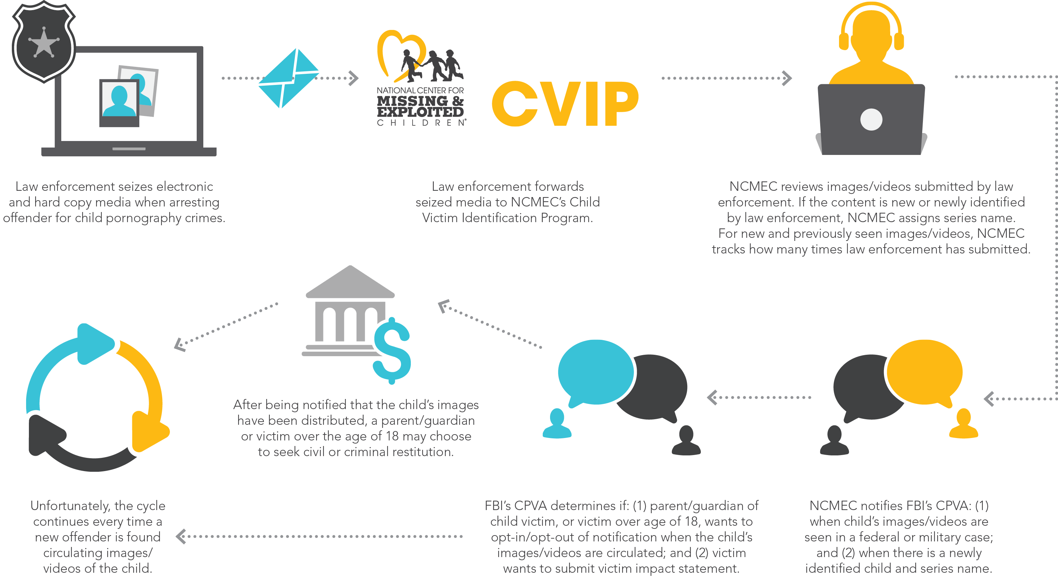
VICTIM NOTIFICATION & IMPACT STATEMENTS
Please do not reproduce or distribute without the written authorization of NCMEC.

Slide 6
RESTITUTION PROCESS
SURVIVOR
SURVIVOR
Please do not reproduce or distribute without the written authorization of NCMEC.
Notes:
RESTITUTION pays for needed services, lost wages, education, therapy, etc
Offender found guilty
Victim Impact Statement read at sentencing by prosecutor
Judge orders restitution amount to be paid by defendant
Defendant (in theory) pays restitution to child for services including: CLOCKWISE: Medical bills, therapy, lost income, education

Slide 7
VICTIMS’ RIGHTS
Identified CSAI Victims: 17,891
Restitution:
39
Receive Notification: 239
Retain Counsel: 62
Actively Traded Victims: 1,894
Impact Statement: 90
As of September 30, 2019
Please do not reproduce or distribute without the written authorization of NCMEC.
Notes:
Actively traded = 11%
Victims receiving notifications are 13% of actively traded victims and 1.3% of all identified victims
Victims with impact statements are 5% of actively traded victims and 0.5% of all identified victims
Victims retaining counsel are 3% of actively traded victims and .3% of all identified victims
Victims seeking restitution are 2% of actively traded victims and .2% of all identified victims
There are fewer than 20 attorneys available to assist these victims.

Slide 8
CONTINUED VICTIMIZATION
First Seen: 2005
# of Files: 833,268
First Seen: 2003
# of Files: 932,202
First Seen: 2003
# of Files: 931,437
First Seen: 2004
# of Files: 879,412
Please do not reproduce or distribute without the written authorization of NCMEC.
Notes:
I’ll update if we want to keep this in
Dalmations
Sandra-M
Inna
Tara

Slide 9
AFTER THE ARREST
While sexual exploitation has stopped, CSAI is still online and in circulation
Continued risks:
Mental Health
Lack of control over/knowledge of who has seen images and videos
Impact of images and videos on developing personal and romantic relationships
Lack of Financial Resources for Rehabilitation/Healing
Lack of financial resources for therapy and life accommodations during recovery
Impact of images and videos on ability to pursue future opportunities (jobs, schools, etc.)
Personal Safety
After child’s identification and rescue, offenders still follow child’s story and real life
Please do not reproduce or distribute without the written authorization of NCMEC.
Notes:
First – immediate aftermath
These are all things we know. Distribution. Mental health/personal safety

Slide 10
PHOENIX 11 ADVOCACY STATEMENT

Slide 11
LEGAL ASSISTANCE

Slide 12
CRIMINAL AND CIVIL RESTITUTION
A child whose CSAI has been distributed online has 2 main avenues to seek legal recovery:
Criminal restitution ordered by a court as part of an offender’s sentencing
Civil restitution awarded by a court/jury in a separate civil lawsuit
Considerations in Pursuing Criminal and/or Civil Restitution
Restitution mandated when requested by the government in criminal case
Important to establish working relationship with prosecutor
Expert report (forensic, therapist, actuarial) is essential
Victim Impact Statements can be powerful means for survivor to have a voice
Collection and tracking of restitution awards can be challenging
Protecting client’s privacy during legal proceedings and media issues is important
Consistently evaluate balance between client’s participation in legal process with their recovery needs
Please do not reproduce or distribute without the written authorization of NCMEC.

Slide 13
Legal Technical Assistance: How can NCMEC Help?
Explanation of Child Victim Identification Program and CyberTipline reports
Affidavits and Attorney Series Information Reports
Legal technical assistance for restitution cases and related proceedings
Handbooks and relevant case law support
Therapeutic and expert referrals
Legal networks and mentorship support
Please do not reproduce or distribute without the written authorization of NCMEC.

Slide 14
Legal Technical Assistance: Explanation of Child Victim Identification Program & CyberTipline Reports
NCMEC’s Child Victim Identification Program and CyberTipline reports and how these programs track distribution of your client’s images
Series names, including situations where series has been renamed, split, and/or contains multiple child victims
Notification process when distribution occurs, including federal agencies involved and how to register to receive notifications on your client’s behalf
Please do not reproduce or distribute without the written authorization of NCMEC.

Slide 15
Legal Technical Assistance: Affidavits and Attorney Series Information Reports
NCMEC can provide 2 core documents to retained counsel relating to client’s CSAI distribution:
Affidavit of active federal prosecutions in which client’s CSAI was distributed
Attorney Series Information Report containing historical background relating to client’s CSAI distribution
Please do not reproduce or distribute without the written authorization of NCMEC.

Slide 16
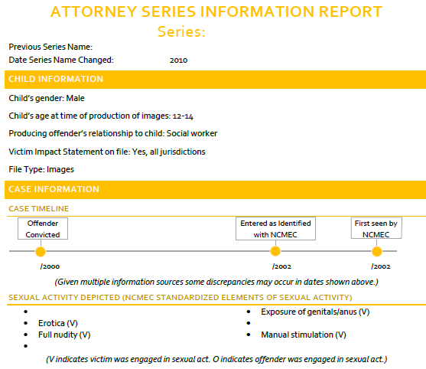
Please do not reproduce or distribute without the written authorization of NCMEC.

Slide 17
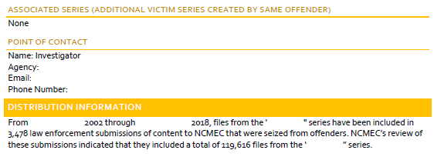
Please do not reproduce or distribute without the written authorization of NCMEC.

Slide 18
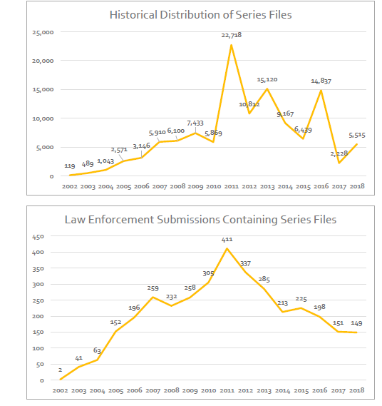
Please do not reproduce or distribute without the written authorization of NCMEC.

Slide 19
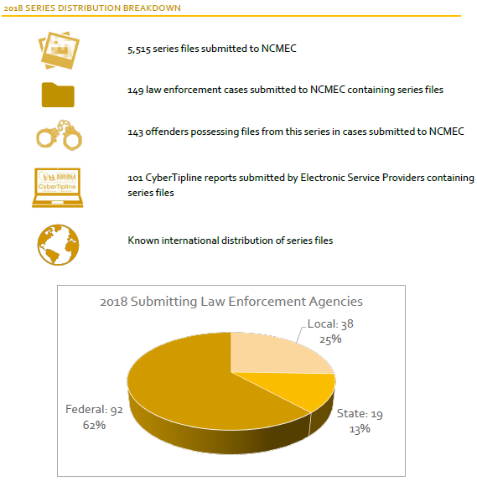
Please do not reproduce or distribute without the written authorization of NCMEC.

Slide 20
Legal Technical Assistance: New Legal Trends, Legislative Opportunities, Attorney Handbook, Attorney Network
Trends relating to emerging case law, including impact of Amy, Vicky, and Andy Act (clarifying determination of restitution for CSAI victims) and alternative legal measures under DMCA
Tracking federal and state legislative initiatives relating to restitution and other legal and statutory issues relating to CSAI victims
Issuance of Attorney Handbook on CSAI Restitution
Creation of NCMEC Attorney Network to provide mentorship and active attorney referrals for CSAI victims seeking private counsel
Please do not reproduce or distribute without the written authorization of NCMEC.

Slide 21
Legal Technical Assistance: Attorney Handbook & Related Trainings
Attorney Handbook to be issued in partnership with Jones Day (anticipated publication second half of 2020)
Handbook will cover nuts and bolts of pursuing criminal or civil restitution
Practical guidance on obtaining expert reports and Victim Impact Statements and working with relevant departments of FBI/law enforcement
NCMEC’s role in tracking distribution of CSAI online and supporting survivors
Ancillary legal issues: custodial/family, privacy, online harassment, state victim fund recovery, DMCA, working with tech companies on removal of images
In connection with publishing the Attorney Handbook, NCMEC anticipates providing ongoing training, conference presentations, and webinars to legal professionals, as well as victim advocates, prosecutors, therapists, and law enforcement who support victims and families upon recovery and throughout their recovery process
Please do not reproduce or distribute without the written authorization of NCMEC.

Slide 22
Legal Technical Assistance: Attorney Network
Please do not reproduce or distribute without the written authorization of NCMEC.

Slide 23
FINDING & REMOVING CONTENT

Slide 24
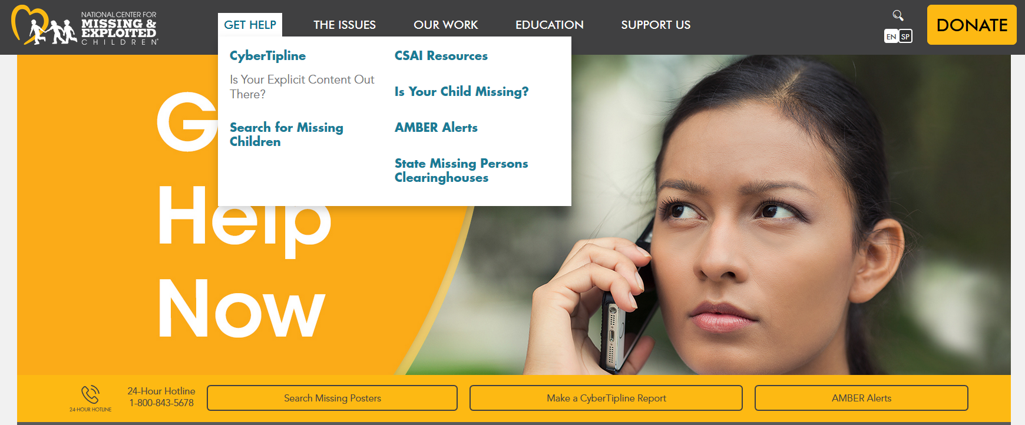
GET HELP NOW: REPORTING
missingkids.org/gethelpnow
Notes:
What are we doing to help these survivors to help these victims
How many have worked cases of Online enticement/self production, how many were files distributed anywhere
Expanded hash sharing and survivors resources

Slide 25
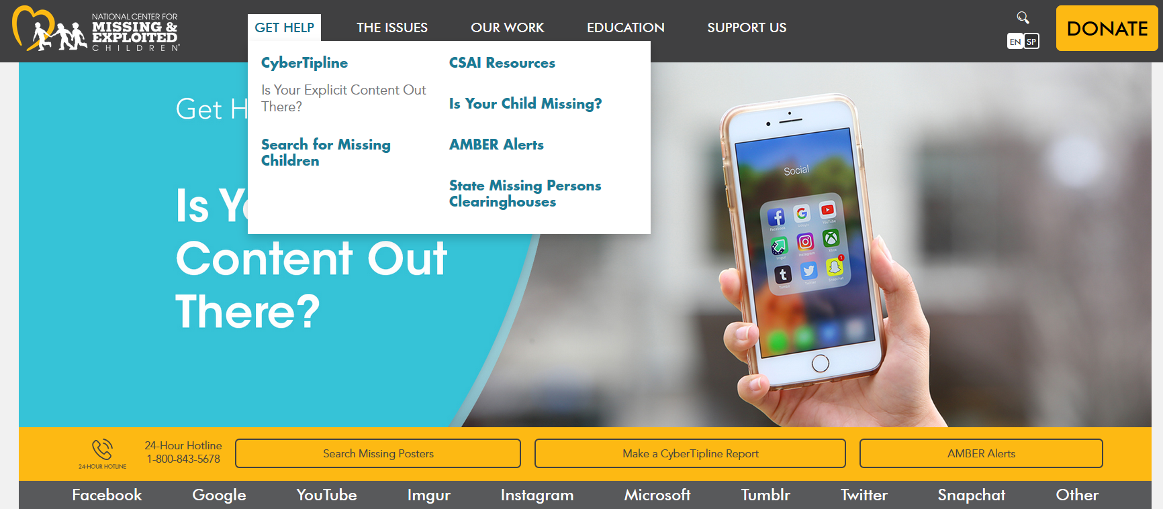
GET HELP NOW: REMOVING CONTENT
missingkids.org/gethelpnow/isyourexplicitcontentoutthere
Notes:
What are we doing to help these survivors to help these victims
How many have worked cases of Online enticement/self production, how many were files distributed anywhere
Expanded hash sharing and survivors resources

Slide 26
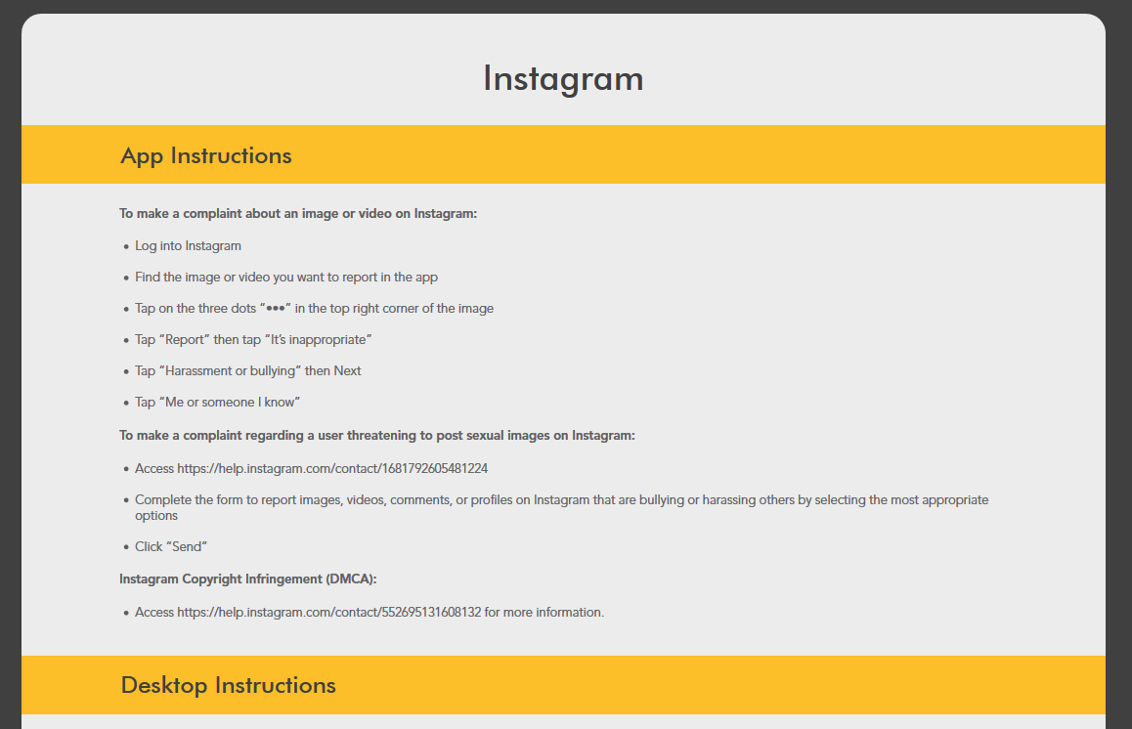
missingkids.org/takeitdown
Notes:
NCMEC has contact information posted on its website on ways to contact some of the most ubiquitous ESPs – the quick links takes the user straight to the Help pages and then down below are the specific instructions provided straight from the ESP on how to notify them of the content
The ESP will then make a CT report if they haven’t done so already, reporting the content itself
Again, the hope is that once they learn of content online, they immediately know they can do something – report it to NCMEC and report it to the ESP
Anyone can contact the “How to” for ESPs

Slide 27
EMOTIONAL AND PEER SUPPORT

Slide 28
HOW DO WE HELP?
Assess & Evaluate
Types of Support Needed
Family Challenges
Moving Forward
Resources & Connections
Please do not reproduce or distribute without the written authorization of NCMEC.
Notes:
Process of finding help for a family
* The Family Advocacy Team is able to assess and evaluate a family’s needs.
* What sort of support is needed: peer support, professional support or prevention support.
* What has a family tried before?
* How do we get them moving forward in whatever way works for them?
* What resources are out there?
* Make the connection!
Assess and evaluate
Types of support needed
Challenges for the family
Moving forward
Resources and connection

Slide 29
TEAM HOPE: PEER SUPPORT
Tools and techniques for supporting referrals
Stress management
Team building skills
Debriefing
Diversity and cultural sensitivity
Trauma
Coping and self-care
Challenges and success for supporting referrals
Listening skills
Notes:
Changes every year with new information that will assist volunteers with the support they provide families. This year we utilized the expertise of our volunteers. They presented on the needs of siblings, step-parents, diversity.
**If you don’t have resources in your community, start with these guys!**
Julia – training for VS’s – CSAI parent, Team HOPE Program Coordinator

Slide 30
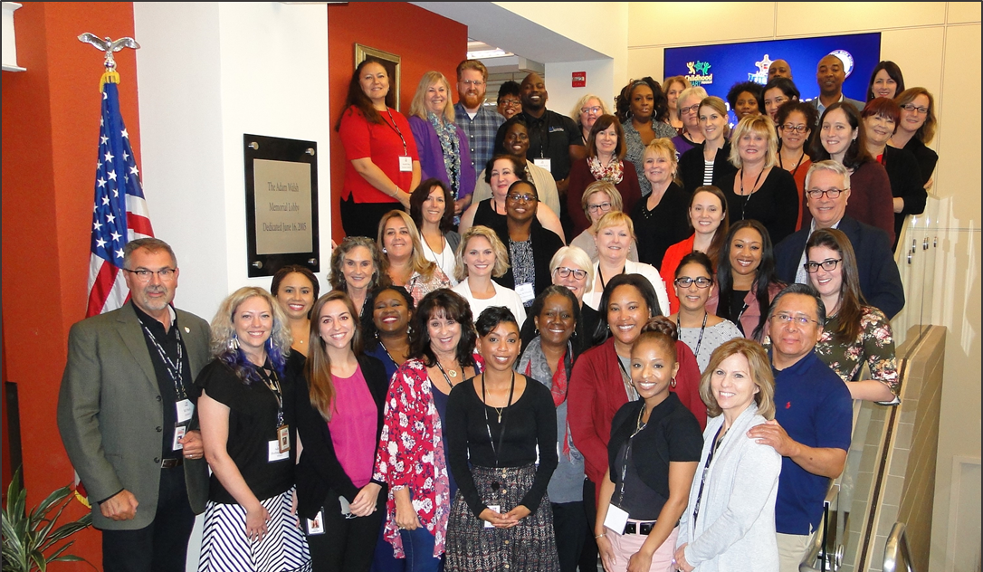
FAMILY ADVOCACY OUTREACH NETWORK
“You really have mental health providers ready and willing to help?”
-Quote from Law Enforcement
Notes:
Lanae
FAON is a voluntary network of mental health professionals and service providers who agree to accept NCMEC cases to support families on a short-term and sometimes longer-term basis at a reduced or pro-bono fee. The goal is to remove the very real and perceived barriers keeping families from accessing the services they need.
CSAI cases require a specific skill-set. We are looking for providers with experience with this population to join our network and provide these families with much-needed mental health support.

Slide 31
LOOKING FORWARD

Slide 32
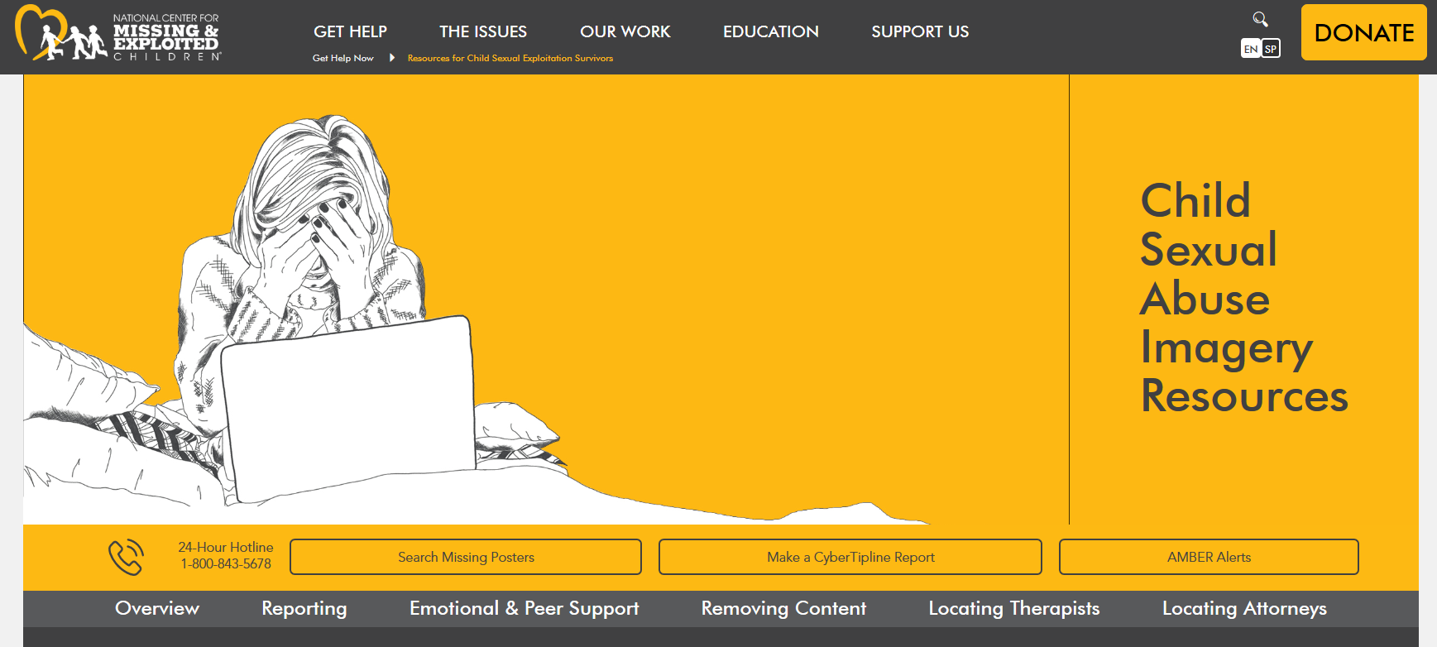
NCMEC Connecting CSAI Victims to Continuum of Resources
missingkids.org/gethelpnow/csai-resources

Slide 33
NCMEC’S CONTINUUM OF CARE
INPUT FROM ALL PARTIES INVOLVED IN HELPING CSAI SURVIVORS
Mental Health
Attorneys
Law Enforcement
Child Protective Services
Victim Advocates
Medical
Probation & Parole
Prosecutors Judges
Education
Family
Media
Tech Companies
March 2020
Please do not reproduce or distribute without the written authorization of NCMEC.
Notes:
Caregivers – March 2020 [non-offending family at the time]

Slide 34
QUESTIONS?

Slide 35
Yiota Souras
Office of Legal Counsel
ysouras@ncmec.org
For complete copyright and grant information, visit MissingKids.org/Legal
Copyright ©2019 National Center for Missing & Exploited Children. All rights reserved.

