Slide 1
Lessons Learned In Victim Advocacy
Jerry O’Neill
Burlington, Vermont
NCVBA Denver 2019

Slide 2
First screening questions: when did this happen; what are the damages?

Slide 3
Don’t fall in love With the client at the first meeting

Slide 4
Get all of the client’s records before you take the case

Slide 5
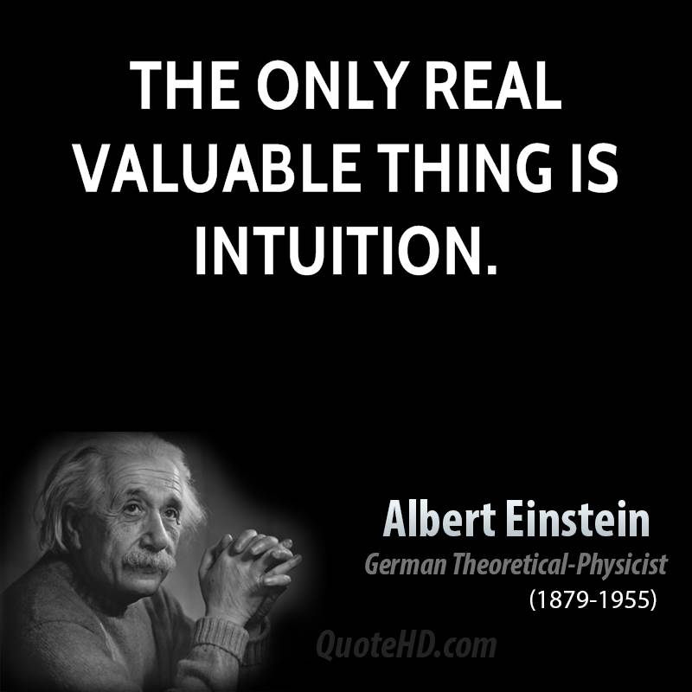
Notes:
Intuitive thought – thinking fast

Slide 6
Be sure you can collect.

Slide 7
Keep a record, with contact information, of the cases you turn down.

Slide 8
Trust
Notes:
First thing to do is to tell the client that you believe them and that this should never happen to anyone. I know you don’t trust me, and that’s ok. I want to earn your trust. Listen, listen. Don’t interrupt except as really needed. Have someone else take notes, quietly. Get the story out and then go back for details. Return calls, emails faster than usual.

Slide 9
Does the Jury Like the Client?

Slide 10
Find the Christa for the case.

Slide 11
Review the jury instructions before filing a complaint

Slide 12
Think carefully before using a treating therapist as your expert in a sexual assault case.

Slide 13
Social Media

Slide 14
Video every deposition you take

Slide 15
Cast of characters
Chronology of events– tied to documents

Slide 16
Think like a juror, not like a lawyer

Slide 17
Choices

Slide 19
Show the defendant as a doer – choices
Notes:
System 2

Slide 20
The greater the number of safe choices that were available to the defendant that jurors effortlessly can think of, the higher the probability the defendant will be judged to have acted unreasonably.

Slide 21
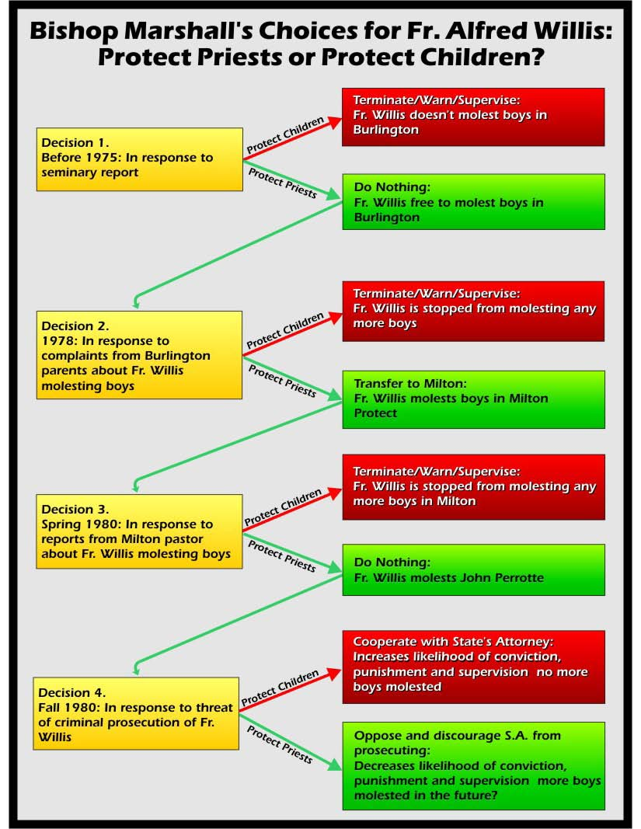

Slide 22
Does the schema fits the jurors expectations?

Slide 23
Establish the Norm – the Rule
Notes:
Confirm it in depositons

Slide 24
We are charged with knowing how jurors make judgments and decisions.

Slide 25
Focus Group

Slide 26
Ask focus group participants how the defendant and plaintiff should have acted to prevent the harm.

Slide 27
A Defendant’s Bad Conduct Can Overcome Defects in the Case
Notes:
Fiery Cushman story about the man who gets into a crash in the rain. Moral reasons are irrelevant – parents anniversary present at home unwrapped – 45% it was the rain, 45% John
Second group, illegal drugs at home to hide before parents get home. John 70%, rain 30%
How defendant acted after the event is important.

Slide 31
Notes:
Thinking slowly.
Cognitive ease.
What happens when we present a complicated matter to the jury – which is why we need demonstrative evidence and an expert who is a teacher.

Slide 32
Establish the alternatives that were available to the parties that would have been both reasonable and safe and would eliminated the harm.

Slide 33
Ask focus group participants to generate alternative safety behaviors ranking them in order of the likelihood the behavior conforms to expectations and norms.

Slide 34
Think about which evidence is introduced first because it has an enormous impact on the judgment. Choose wisely!

Slide 35
Simply changing the order that information is presented changes judgment.

