Slide 1
SECRET SETTLEMENTS: Truth and Consequences
Erin K. Olson
National Crime Victim Bar Association
December 6, 2019

Slide 2
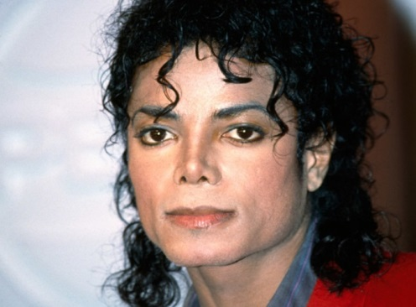
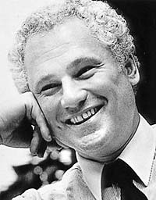
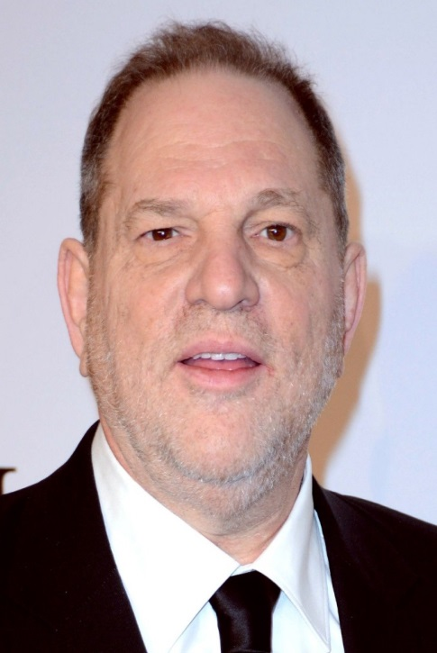
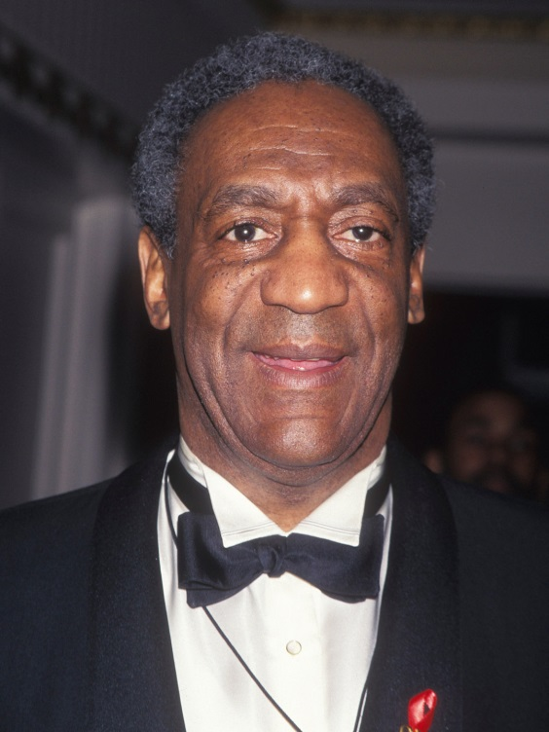
What Do These Men Have in Common?

Slide 3
They all bought the silence* of women or children they had sexually assaulted.
“Michael Jackson paid out approximately
$25 million to settle a civil suit”
“Harvey Weinstein’s Secret Settlements”
“The 30-Year Secret: A crime, a cover-up
and the way it shaped Oregon”
“How Bill O’Reilly Silenced His Accusers”
“Bill Cosby paid $3.38 million to settle previous
sexual assault claim by woman now accusing him”
*In 1994, during the criminal investigation into allegations that Michael Jackson had sexually abused a child, Larry Feldman, attorney for the accuser, said "nobody bought anybody's silence.“ A few months later, the criminal matter was closed due to noncooperation by the victim and his family.

Slide 4
Why would anyone agree to that?
$23 million (Michael Jackson, one accuser*)
??? (Harvey Weinstein, ??? accusers)
$350,000 (Neil Goldschmidt, one accuser)
$45 million (Bill O’Reilly, six accusers)
$3.38 million (Bill Cosby, one accuser)
* $15,331,250 to be held in trust for the victim, $1.5 million for each of his parents, and $5 million for the family's lawyer.

Slide 5
Isn’t that illegal?
(1) A person commits compounding if he accepts or agrees to accept any pecuniary benefit as consideration for:
(a) Refraining from seeking prosecution of an offender; or
(b) Refraining from reporting to law enforcement authorities the commission or suspected commission of any crime or information relating to a crime.
(2) It is an affirmative defense to prosecution under this section that the benefit received by the defendant did not exceed an amount which the defendant reasonably believed to be due as restitution or indemnification for harm caused by the crime.
(3) Compounding is a class 3 misdemeanor.
Colo. Rev. State. § 18-8-108

Slide 6
Isn’t that illegal?

Slide 7
Isn’t that illegal?

Slide 8
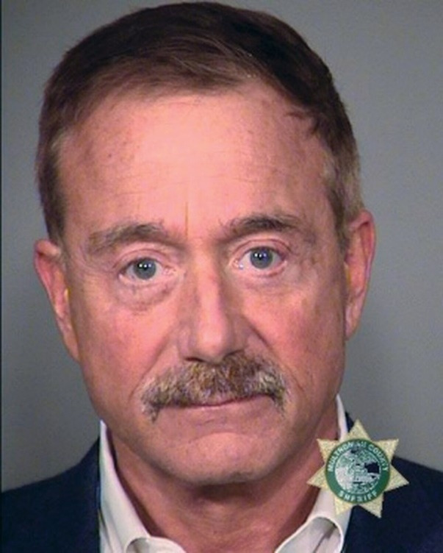
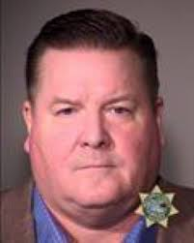
Isn’t that illegal?
Portland developer Terry Bean and his
former attorney Derek Ashton arrested in
alleged witness payoff

Slide 9
Isn’t that unethical?
.
Notes:
In an O’Reilly case settlement, the terms of the agreement include a provision that says the lawyers representing Ms. Mackris are agreeing to switch sides and advise O’Reilly on other sexual harassment claims. Ms. Mackris’ lawyers also agreed not to represent any other client who may have a claim against O’Reilly and Fox

Slide 10
Isn’t that unethical?
A lawyer shall not participate in offering or making:
* * *
(b) an agreement in which a restriction on the lawyer's right to practice is part of the settlement of a client controversy.
RPC 6(b)

Slide 11
Isn’t that unethical?
A lawyer shall not:
* * *
(a) unlawfully obstruct another party' s access to evidence or unlawfully alter, destroy or conceal a document or other material having potential evidentiary value. A lawyer shall not counsel or assist another person to do any such act[.]
RPC 3.4(a).

Slide 12
Isn’t that unethical?
A lawyer shall not:
* * *
(f) request a person other than a client to refrain from voluntarily giving relevant information to another party unless:
(1) the person is a relative or an employee or other agent of a client; and
(2) the lawyer reasonably believes that the person's interests will not be adversely affected by refraining from giving such information.
RPC 3.4(f).

Slide 13
Aren’t there tax consequences?
“It is further understood that part of the consideration for this Agreement and Release includes an agreement that Rodman and Amos shall not at any time from the date of this Agreement and Release forward disparage or defame each other.”
Amos v. Commissioner of Internal Revenue, 2003 TC Memo 329, 15 (U.S. Tax Court 2003)

Slide 14
Aren’t there tax consequences?
IRS Found that $80K of $200K settlement was taxable because it was for Amos’s agreement not to:
(1) defame Mr. Rodman,
(2) disclose the existence or the terms of the settlement agreement,
(3) publicize facts relating to the incident, or
(4) assist in any criminal prosecution against Mr. Rodman with respect to the incident[.]”
Notes:
Options: (1) Don’t agree to it; (2) Demand tax indemnity; (3) allocate small sum to confidentiality (arguably this would be the damages for breach); (4) bargain over the amount (again, this would likely be liquidated damages amount); (5) make it mutual and do not assign a value.

Slide 15
Doesn’t it violate public policy?
“Confidentiality prevents the public from knowing about systemic wrongful conduct. It can also prevent regulators and government agencies from performing their duty to enforce the law and protect the public. The purpose of the court is to evenly administer justice to all so that all are protected by the law. When violations are hidden by confidentiality, the legal system itself is thwarted from fulfilling one of its fundamental purposes: to protect the citizenry from wrongful conduct.”
Burdge, Ronald L. “Bad for Clients, Bad for Lawyers, Bad for Justice.” GPSolo, vol. 29, no. 6, 2012, pp. 25–27. JSTOR, www.jstor.org/stable/23631211.

Slide 16
Are there any “pros,” or just “cons”?
It depends . . .
“Gag” orders that prevent a victim from discussing the underlying facts are rarely appropriate. . . or healthy.
Non-disparagement clauses? Are they mutual?
Confidentiality of settlement terms?
Confidentiality of settlement amount?
Purported third party restrictions?
Enforcement mechanism?

Slide 17
Are there any “pros,” or just “cons”?
(1) Protection from shame, embarrassment, and
damage to reputation of having facts of the case
become public, especially if pre-filing or pre-publicity.
(2) In employment context, protects victim from having
potential employers avoid hiring due to suit against
prior employer.
(3) Facilitates settlement, often early in the case, thus
limiting painful, invasive discovery and reducing costs.
(4) Protection from greedy family members and “new
best friends.”

Slide 18
Enforcement Mechanisms
Liquidated damages (= specific consideration for confidentiality?)
Contract damages
Binding arbitration / czar clause
Disgorgement of consideration

Slide 19
Enforcement Mechanisms: Disgorgement
“13. Confidentiality ... [T]he plaintiff shall not either directly or indirectly, disclose, discuss or communicate to any entity or person, except his attorneys or other professional advisors or spouse any information whatsoever regarding the existence or terms of this Agreement... A breach ... will result in disgorgement of the Plaintiffs portion of the settlement Payments.”
--- Confidentiality clause at issue in Gulliver Schools, Inc. v. Snay,
137 So.3d 1045, 2014 WL 769030 (Fla. Ct. App. 3rd Dist. 2014).

Slide 20
Enforcement Mechanisms: Disgorgement
“Mama and Papa Snay won the case against Gulliver. Gulliver is now officially paying for my vacation to Europe this summer. SUCK IT.”
Notes:
Dana Snay is now a 2L at Emory University Law School.

Slide 21
What is the market value of silence?
1. How scandalous is the subject matter of the secret?
2. What harm did the subject matter cause to the victim?
3. What does the perpetrator have to lose if the subject
matter is exposed?
4. What is the financial ability of the perpetrator (or an
interested third party) to pay a settlement?
5. Will the perpetrator’s employer or business will also be
financially harmed if the subject matter comes out?

Slide 22
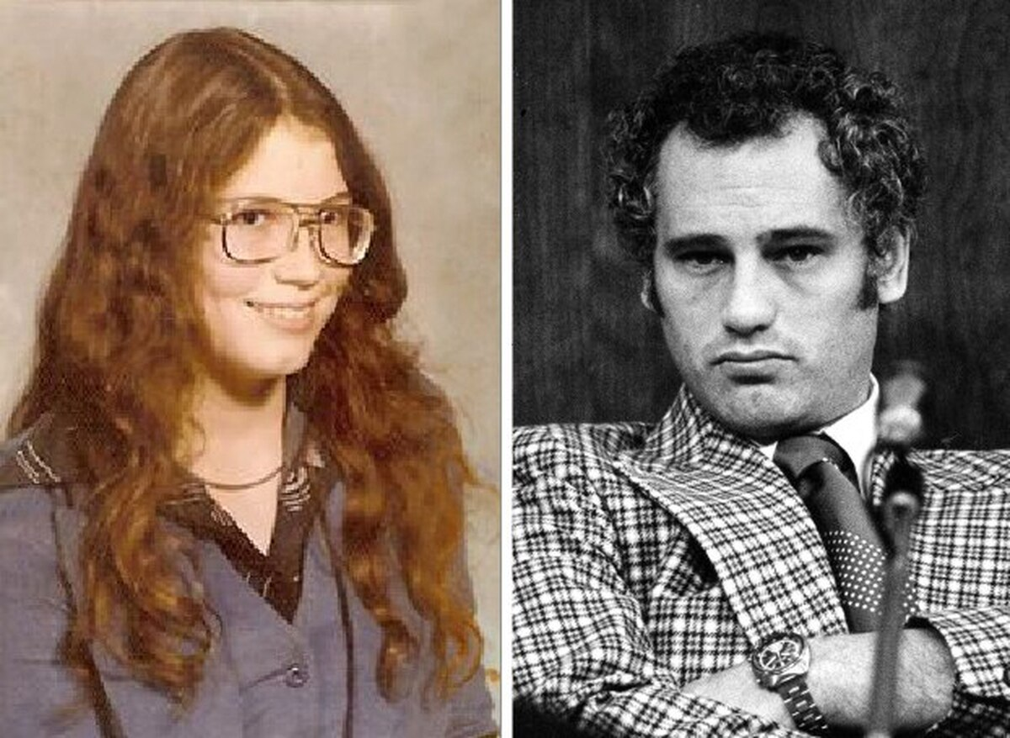
What are the consequences of silence?
1975 Portland’s new mayor, Neil Goldschmidt, begins having sex with a 13 year-old neighbor.

Slide 23
Consequences of silence?
1977 Goldschmidt’s victim drops out of high school at 15.
1979 Goldschmidt is appointed Secretary of Transportation
by President Carter.
1986 Goldschmidt is elected Governor of Oregon.
1988 Goldschmidt’s victim is behaving erratically in Portland, and Goldschmidt arranges a job for her in Seattle. Not long after she relocates to Seattle, she is
raped at knifepoint by a stranger, who is apprehended. His defense attorney seeks to admit evidence of the
victim’s prior sexual assaults by Goldschmidt at trial.
Notes:
Rapist – Jeffrey Lynn Jacobsen, King Co 89-1-00303-8. Becky prosecuted.

Slide 24
Consequences of Silence
1990 Goldschmidt, worried about exposure in the Washington case, does not seek a second term as governor.
1990 to Goldschmidt’s victim, back in Portland, is arrested more 1994 than a dozen times, mostly for drug or alcohol-related offenses. She enters inpatient treatment in 1993.
1994 She hires an attorney in 1994. A conservator is appointed
for her because she is “financially incapable.”
1994 Goldschmidt settles with his victim in a deal mediated by a prominent Oregon personal injury lawyer. She receives 30,000 in cash and an annuity that paid her $1,500 per month for 10 years. In addition, she was to receive lump- sum payments of $50,000 in 2005, 2010 and 2015.
Notes:
Speculation that it was the women who came forward to accuse Sen. Bob Packwood that encouraged her to come forward.

Slide 25
Consequences of Silence
2004 Willamette Week notifies Goldschmidt it is about to publish a story about the abuse and the secret settlement. Over the next 24 hours, Goldschmidt resigned from the Oregon State Bar and the Oregon Board of Higher Education, and met with an Oregonian reporter to “confess” to “having an “affair” with a high school student” when he was mayor. He moves to France with his second wife.
The Willamette Week reporter wins a Pulitzer. The
Oregonian acknowledges it first heard about the abuse in 1986.
Notes:
Sen. Vicki Walker, herself a victim of CSA and the voice that led the OR Senate to pass an extended child abuse SOL bill years later, tipped off the WW reporter.

Slide 26
Consequences of silence?
January 16, 2011
After decades of battling substance abuse, mental illness, and despair, Goldschmidt’s victim died at the age of 49.
Her name was Elizabeth Dunham.

Slide 27
What can/should we do?
“Notwithstanding any other provision of law, a confidential settlement agreement is prohibited in any civil action the factual foundation for which establishes a cause of action for civil damages for an act that may be prosecuted as a felony sex offense.”
Cal. Civ. Pro. Code § 1002(a).

Slide 28
SECRET SETTLEMENTS: Truth and Consequences
Erin K. Olson
National Crime Victim Bar Association
December 6, 2019

