Slide 1
NCVBA CSA SECTION
CLOSING ARGUMENT
Dave Ring
Taylor & Ring
Ring@TaylorRing.com

Slide 2
Felicia m. v. county of los Angeles

Slide 3
Quick Facts
Felicia molested by men in home
Home was under investigation for “neglect” by DCFS
In the course of investigation, DCFS then suspected sexual abuse
DCFS failed to report suspected sexual abuse to police
“Mandated Reporters” of child abuse

Slide 4
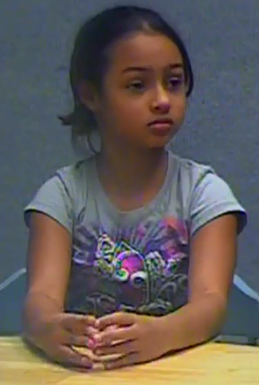
Plaintiff: Felicia m.
Age 9

Slide 5
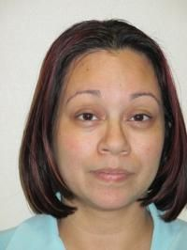
FELICIA’S MOTHER: NELLA TRAN
CONVICTED

Slide 6
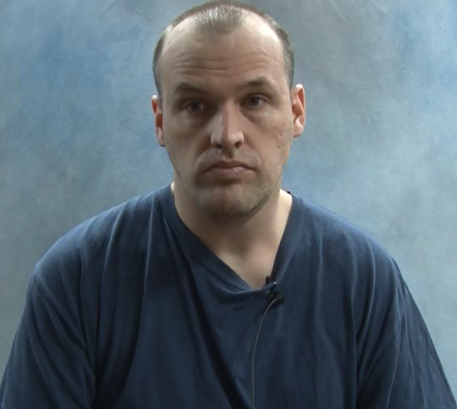

Perpetrator: louis fluet

Slide 7
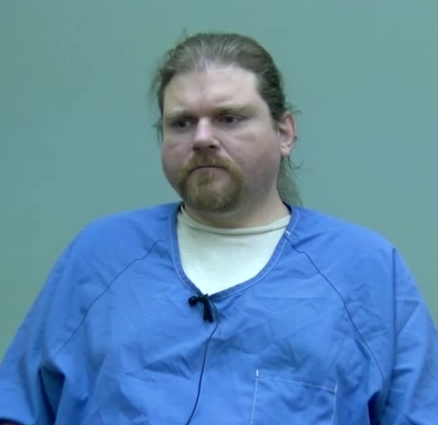
Perpetrator: TIMOTHY MARTINSON

Slide 8
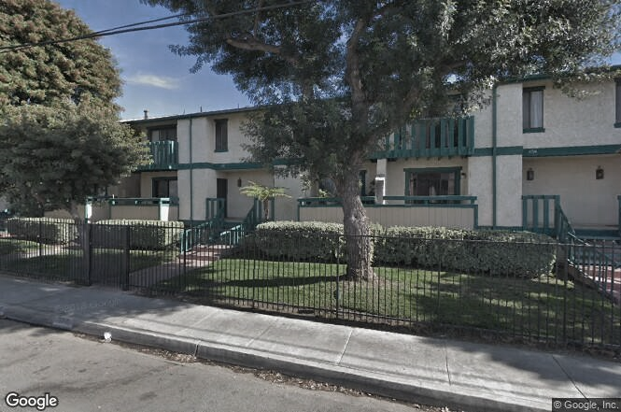
El monte townhouse

Slide 9
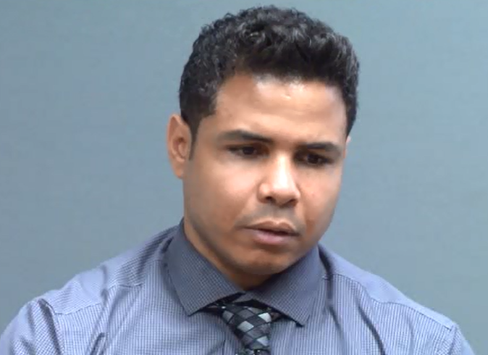
FELICIA’S FATHER: DANNIS MARQUEZ
Guardian for minor at trial

Slide 10
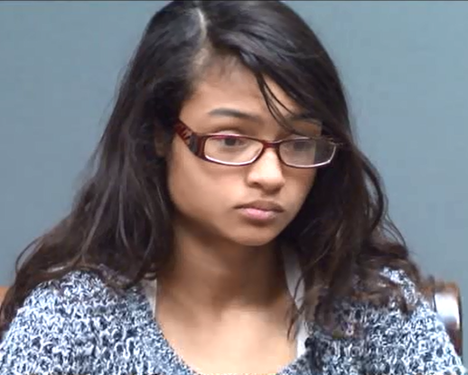
FELICIA AT TIME OF TRIAL
AGE 15

Slide 11
closing
Tell the jury WHAT you want them to do............
AND
HOW to do it

Slide 12
Format for every case
Intro
Empower Jury
The Basics
Themes: which lead into liability....

Slide 15
liability
Graphics
Timelines
Key Exhibits
Key Testimony
ARGUE! –– Do NOT summarize the FACTS/ TESTIMONY!

Slide 16
DAMAGES
ECONOMIC

Slide 17
DAMAGES
NON-ECONOMIC

Slide 20
General damages
Numbers on board
Age 7-9: $_____________________
Age 9-15: $_____________________
Age 15-25: $_____________________
Age 25-35: $_____________________
Age 35→: $_____________________
($90 Million)
PAST
FUTURE

Slide 21
APPORTIONMENT OF FAULT

